Slide 1
Storyboard Finding a way forward
«KIZ SINNOVA»

Slide 2
Why creative techniques?
Creative techniques offer a different way of exploring motivations, emotions, feelings. Especially in times of change and transition creative techniques can help to deal with an uncertain, unpredictable future. Some coachees and mentees will find it very difficult to formulate concrete, realistic goals. A creative technique can help to activate different parts of the brain and help to create a way forward.
Limitation: Most people do not believe they are creative and feel limited when comes to drawing or creative writing.
Advantage: Creative techniques can offer a non-directive form of support where the coachees/mentees can experiment with different forms of expressing themselves. Creating visual outputs can be liberating and a reference for future mentoring/coaching conversations.
Target audience: Creative techniques are not for everyone. Storyboards offer time and space to think about what the future could look like and help to develop a sense of control about the coachee’s/mentee’s own story.
Expected outcome: A storyboard offers a visual to reflect on, identify action points, offers orientation, can contribute to become unstuck.
KIZ SINNOVA, 06.2022

Slide 3
Context
Storyboards
Create a visual ‘action plan’
Represent a preferred story
Can be used in situations where coachees/mentees find it difficult to formulate realistic goals and clear direction of what should happen in their lives
Storyboards
Can be a first draft of a still unclear future
Can help to identify activities to move forward
Can contribute to overcome language barriers
Can help to manifest what is important and relevant for the mentees/coachees
KIZ SINNOVA, 06.2022

Slide 4
Storyboard
Start by drawing 6 boxes. The first box is the starting point the last box the end point (of the story)
All boxes contain graphic elements and 1 (!) word, preferably a verb
START | ACTIVITY 1 VERB | ACTIVITY 2 VERB
ACTIVITY 3 VERB | ACTIVITY 4 VERB | END
KIZ SINNOVA, 06.2022

Slide 5
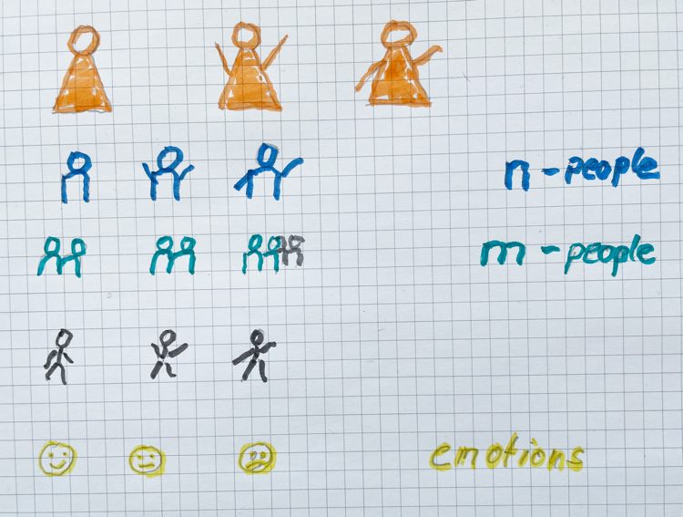
Start by drawing people and emotions
To draw people you can use stick figures, A-people, n-people or m-people
To draw emotions you might want to use smileys
Use different coloured markers, pencils
Remember: this is a draft, no need for perfection!
KIZ SINNOVA, 06.2022

Slide 6
A way forward
to coddiwomple
To travel in a purposeful manner towards a vague destination
Tip:
You don‘t need to know exactly where you are going
It is perfectly ok to experiment and find out what the destination will look like as you move forward
Expect the unexpected, a surprise element, as you go along.
Ideas and solutions will present themselves
KIZ SINNOVA, 06.2022

Slide 7
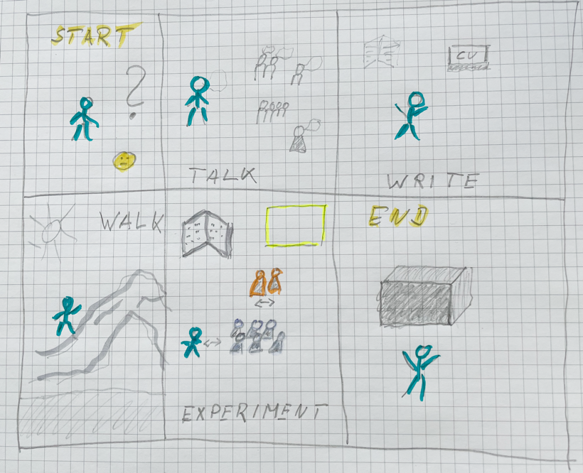
Storyboard: example
How to coddiwomple?
What can you do (activities)
to get to the endpoint?
The empty frame
represents an element
of surprise. You don’t need
To know what it is now!
How do you feel
along the way?
Black box, when you
don’t know how the
endpoint looks like
Use one word to describe
the activity,
preferably a verb
How do you feel when
you get there?
KIZ SINNOVA, 06.2022

Slide 8
What next? Use the storyboard as a reference in future coaching and mentoring sessions. Ask your coachee/mentee to describe their storyboard and to find their own way to present it. Encourage your coachee/mentee to tell and own their story.

Slide 9
More information: YES! Thinking Space https://youngentrepreneurssucceed.com/thinking-space/

