Slide 1
Mentoring Workshop 2 for Mentors

Slide 2
Agenda
Approach to Mentoring
Processes in mentoring: Garvey's 3-Stage Model
Variations of the 3-Stage model
Ground Rules - Dimensions
Questions and answers

Slide 3
Opening Question
What do you do to make sure you keep well?

Slide 4
Approach to Mentoring
“Mentoring is a learning relationship between two people. It requires trust, commitment and emotional engagement. It involves listening, questioning, challenge and support. It has a time scale.” Prof. Bob Garvey
»Mentees are the experts for their life and their business.«
Mentoring works best when the mentee is in phase of transition. For entrepreneurs that means mentoring is part of the post-start-up support. Mentoring can be an addition to existing training/coaching programmes or a stand-alone solution.
Mentoring usually involves working on three levels: The mentee’s business, personal development and the relationship between mentee and mentor
Mentee‘s
Business
Person
Relationship

Slide 5
Experiential Learning
Development takes place primarily through reflection and application in practice!
Concrete Experience
Test implications in new situations
Observation Reflection
Concepts
Generalizations
Kolb‘s Learning Cycle (1984)
Example/Demo

Slide 6
3-Stage-Model (B. Garvey)
Mentoring involves a number of processes. Different mentors have different strengths and work in different ways. Regardless of which approach or style you use, it makes sense to work within a process framework to offer the mentee an opportunity to make the most of the sessions.
I. Exploration
III.
Activity Planning
II.
New Understanding
Hinweise:
Zeit (5‘)
Rollenspiel/Demo

Slide 7
Exercice
Breakout session:
In groups of 2:
1 person takes on the role of mentor,
1 person takes on the role of mentee
Suggested topics:
What is going through your mind right now?
How can you apply the 3-step model?
Time : 15'
Hinweise:
Teilnehmer fragen, ob pünktlich gestartet werden soll oder es Sinn ergibt, auf weitere TN zu warten
Die TN noch einmal offiziell begrüßen und die Agenda kurz vorstellen (3‘)

Slide 8
3-Stage-Model (G. Egan)
Guiding questions
I. What happened, what is the story?
II. What really happened? Who confirmed the story?
III: What would be the preferred story? What can you do differently/better next time?
I.
Story
III.
Preferred Story
II.
Real Story
Hinweise:
Zeit (5‘)
/Demo

Slide 9
3-Stage-Model (M. Pegg)
Guiding questions
What is the concern/topic and the mandate? What is to be achieved in the mentoring session?
What solutions are conceivable? What could be done differently right now?
What are the next, concrete steps?
I.
Clarity
III.
Concrete
Action
II.
Creative
Solutions
Hinweise:
Zeit (5‘)
/Demo

Slide 10
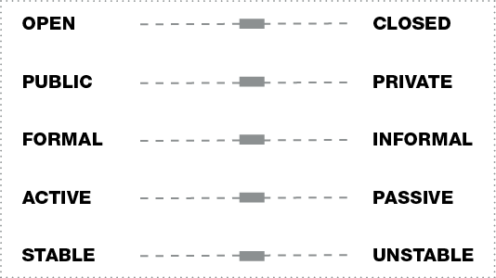
Ground Rules: Dimensionen (B. Garvey)
Garvey, Bob (1994: 18)

Slide 11
References and suggested reading Alred, G. and Garvey, B. (2019) Mentoring. La Vergne: Management Pocketbooks (Management Pocketbooks). Egan, G. (2018) The skilled helper : a client-centred approach. 2nd edition. EMEA edition. Australia: Cengage. Garvey, B. (1994) “A Dose of Mentoring,” Education & Training, 36(4), pp. 18–26. Garvey, B., Stokes, P. (2022) Coaching and Mentoring : theory and practice. 4th edition. London: SAGE. Kolb, D. A. (2015) Experiential learning : experience as the source of learning and development. Second edn. Upper Saddle River, New Jersey: Pearson Education. Pegg, M. (2020) The Positive’s Encouragers Book: The art of encouraging people during our time on the planet. UK: The Strengths Organisation Ltd. Available from: <https://www.thepositiveencourager.global/the-positive-encouragers-book />

Slide 12
More information: YES! Thinking Space https://youngentrepreneurssucceed.com/thinking-space/

